Slide 1
Predictive Analysis of Academic Performance via Social media Influence Metrics
Frontier Tech Leaders Programme Global Cohort 1
Student Name: Alamou Shola Mouhsine DAOUDA
Date : 12-12-2023

Slide 2
How to use this template
Frontier Tech Leaders Programme Global Cohort 1
Download the file
Change the name into "Name_Surname_Draft_Presentation"
Do not move the text boxes, keep your text and visuals inside the boxes
Do not change the colors and font type
If you need to change the font size make it consistent and don't use different sizes in one page (biggest 28, smallest 16). Titles always should be 44.
You can duplicate a page if you need more than one pages
Add high quality pictures and their sources. Keep it inside the boxes.
Key color - #2B2551​
Supporting color 1 - #FFC837 ​
Supporting color 2 - #4CA3AA ​
Supporting color 3 - #FFFFFF​
Supporting color 4 - #FF577D
Remove this page before uploading the presentation to your Github repository!

Slide 3
Outline
Frontier Tech Leaders Programme Global Cohort 1
Concept note and implementation plan:
Background
Objectives
SDG Relation
Data
Data Collection
Exploratory Data Analysis (EDA) and Feature Engineering
Model Selection and Training
Model Evaluation and Hyperparameter Tuning
Model Refinement and Testing
Results
Deployment
Future Work

Slide 4
Concept note and implementation plan
Frontier Tech Leaders Programme Global Cohort 1

Slide 5

Background
Frontier Tech Leaders Programme Global Cohort 1
In the era of pervasive smartphones and advanced mobile technologies, the profound impact of social media has sparked extensive discussions.
This project endeavors to predict and comprehend the academic performance of university students by delving into the nuanced facets of social media influence. Key factors, including time spent on social media, the number of friends, platform usage, group involvement, and other relevant metrics, are scrutinized.

Slide 6
Objectives
Frontier Tech Leaders Programme Global Cohort 1
The specific objectives of this project are to develop a predictive model that utilizes machine learning techniques to analyze the impact of social media on academic performance. By identifying key social media influence factors, the project aims to provide actionable recommendations for fostering improved learning outcomes. The ultimate goal is to contribute to the development of strategies that positively impact students' academic achievements.
The primary aim of the machine learning model in this project is to develop a predictive tool that leverages advanced techniques to analyze the influence of social media on academic performance.

Slide 7

SDG Relation
Frontier Tech Leaders Programme Global Cohort 1
This project directly aligns with SDG 4 (Quality Education) by addressing factors that impact academic performance of students. By unraveling the relationship between social media influence and academic outcomes, the project contributes to the development of strategies for fostering a high-quality education environment.

Slide 8
Data
Frontier Tech Leaders Programme Global Cohort 1

Slide 9
Data Collection
Online Survey by UPSA researchers
Exploring Connectivity, Engagement, and Demographics
Exploring Academic Engagement: A Survey of UPSA Virtual Students
Data Sufficiency: 623 Student Profiles

Slide 10
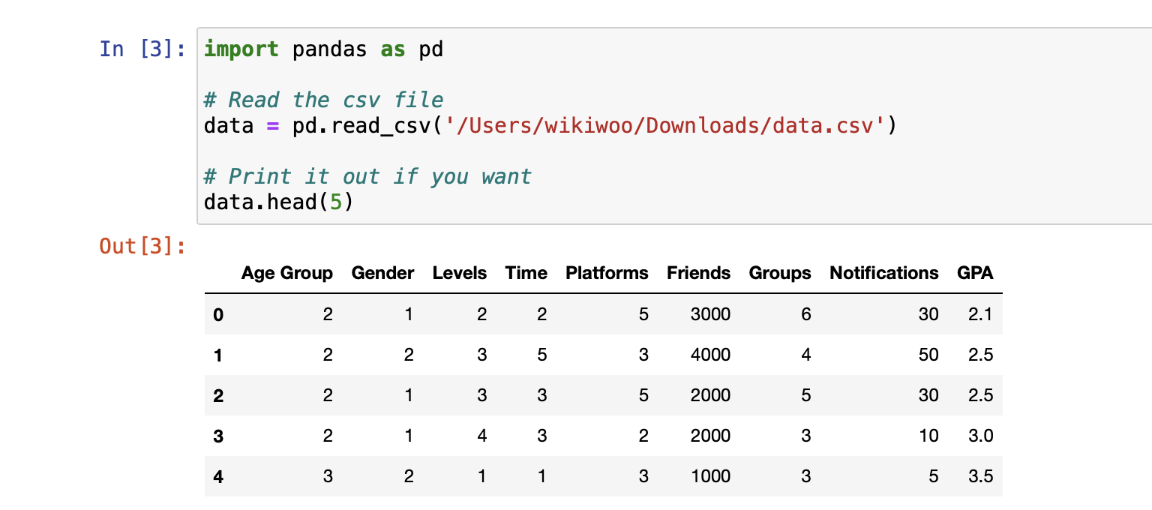
Data Collection
Frontier Tech Leaders Programme Global Cohort 1
Age Group | 1: 20 years or below 2: [20, 30] 3: above 30 years
Gender | 1: Male 2: Female
Levels | 100 level to 400 level
Time | number of hours students spend on social media
Platforms | number of social media platforms a student belongs to

Slide 11
Data Collection
Frontier Tech Leaders Programme Global Cohort 1
Friends | number of friends a student has on social media
Groups | number of social media groups a student belongs to
Notifications | number of times a student checks notifications on social media daily
GPA | Grade Point Average of the student, which serves as a measure of their academic performance

Slide 12
Exploratory Data Analysis (EDA) and Feature Engineering
Frontier Tech Leaders Programme Global Cohort 1
Explain the process of creating or transforming features
Rationale behind feature engineering decisions
Describe scaling, normalization, encoding, etc.

Slide 13
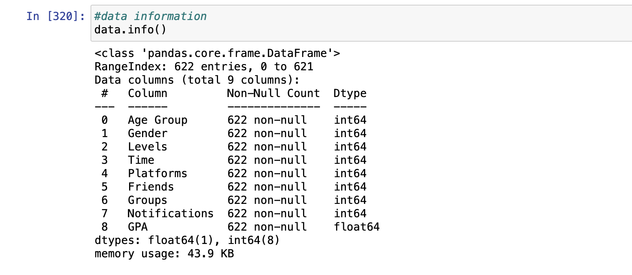

Exploratory Data Analysis (EDA) and Feature Engineering
Frontier Tech Leaders Programme Global Cohort 1
DATA INFO The DataFrame consists of 622 entries with 9 columns, including a combination of integer (int64) and float (float64) data types.

Slide 14
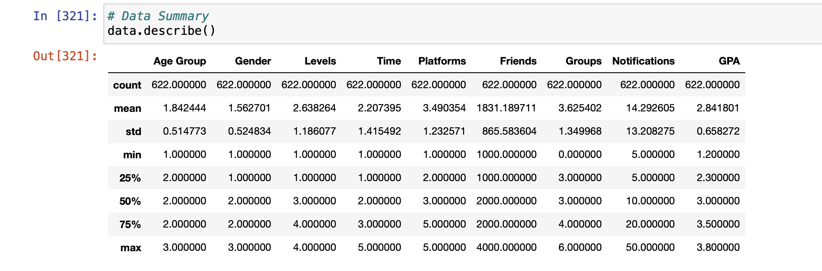
Exploratory Data Analysis (EDA) and Feature Engineering
Frontier Tech Leaders Programme Global Cohort 1
DATA DESCRIPTION

Slide 15
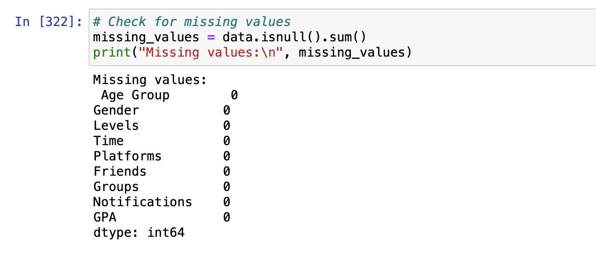
Exploratory Data Analysis (EDA) and Feature Engineering
Frontier Tech Leaders Programme Global Cohort 1
NULL SUM There is no missing value, we can proceed with the data analysis directly without any modifications.

Slide 16
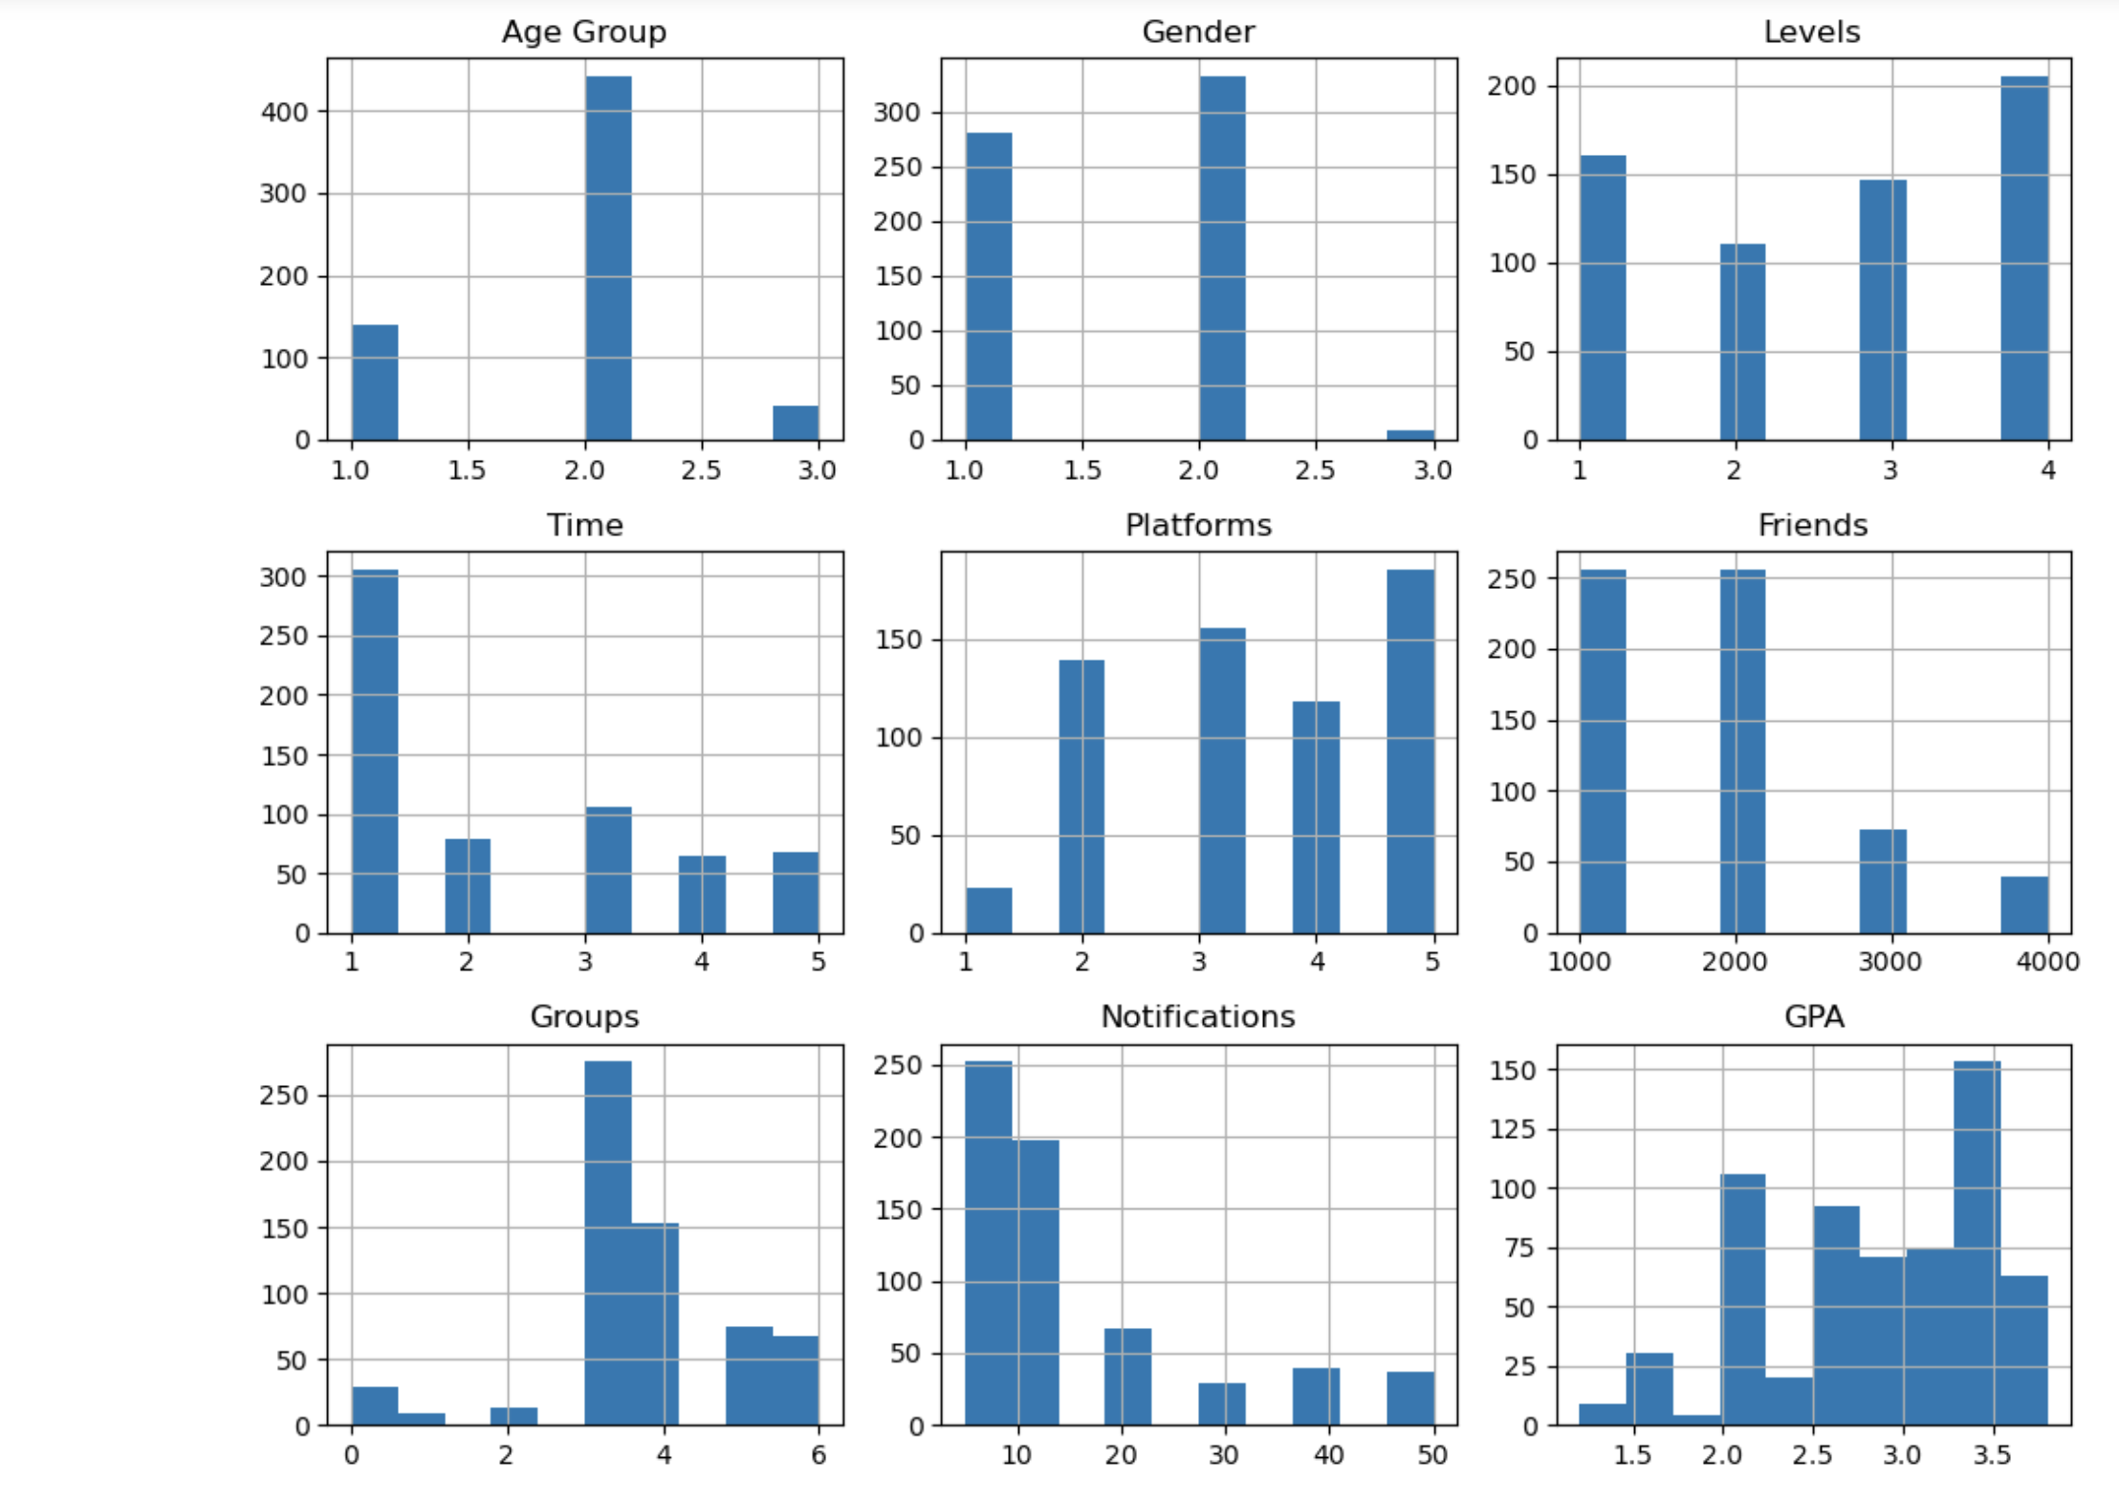
Exploratory Data Analysis (EDA) and Feature Engineering
Frontier Tech Leaders Programme Global Cohort 1
HISTOGRAMME

Slide 17
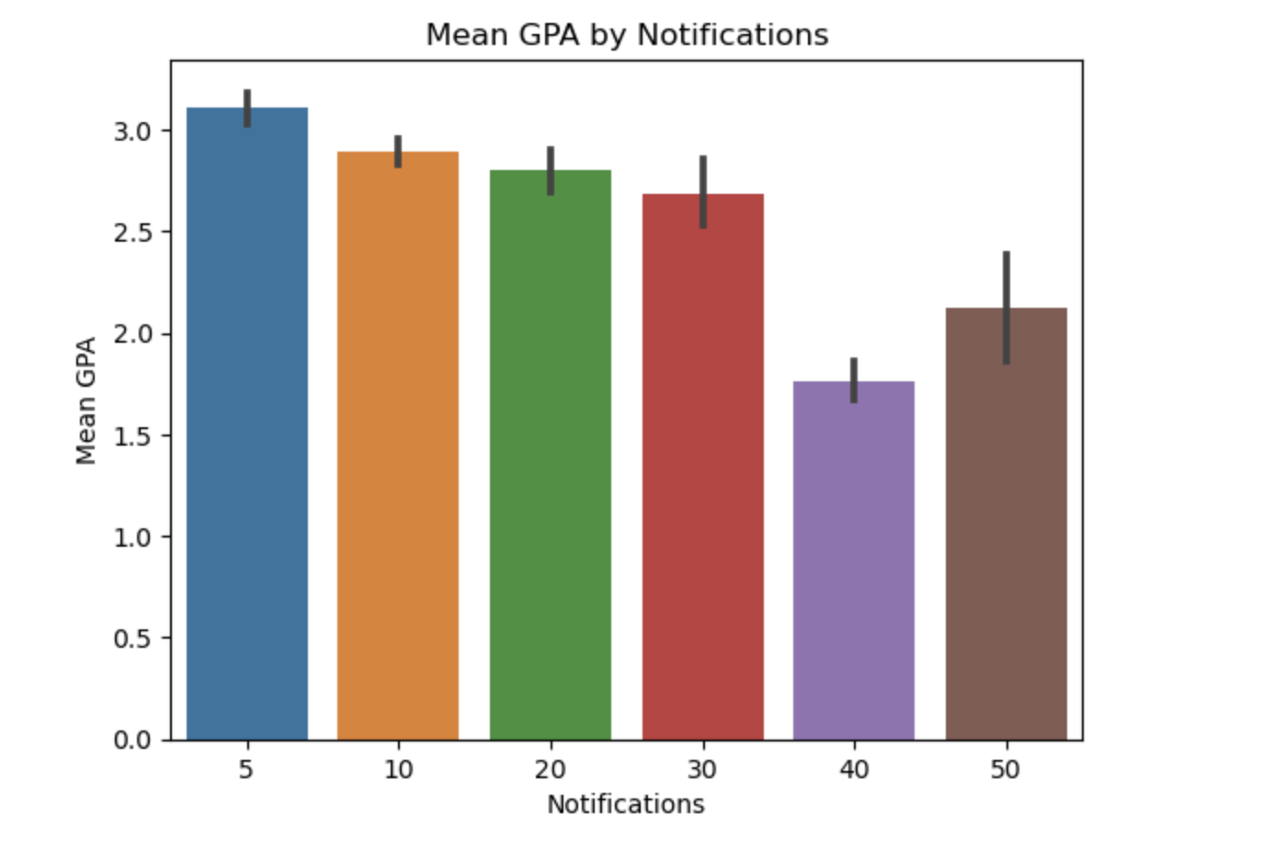
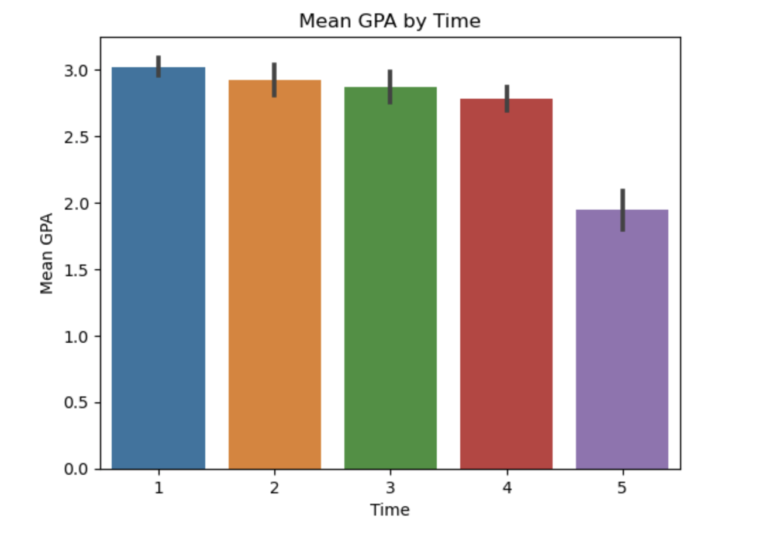
Exploratory Data Analysis (EDA) and Feature Engineering
Frontier Tech Leaders Programme Global Cohort 1

Slide 18
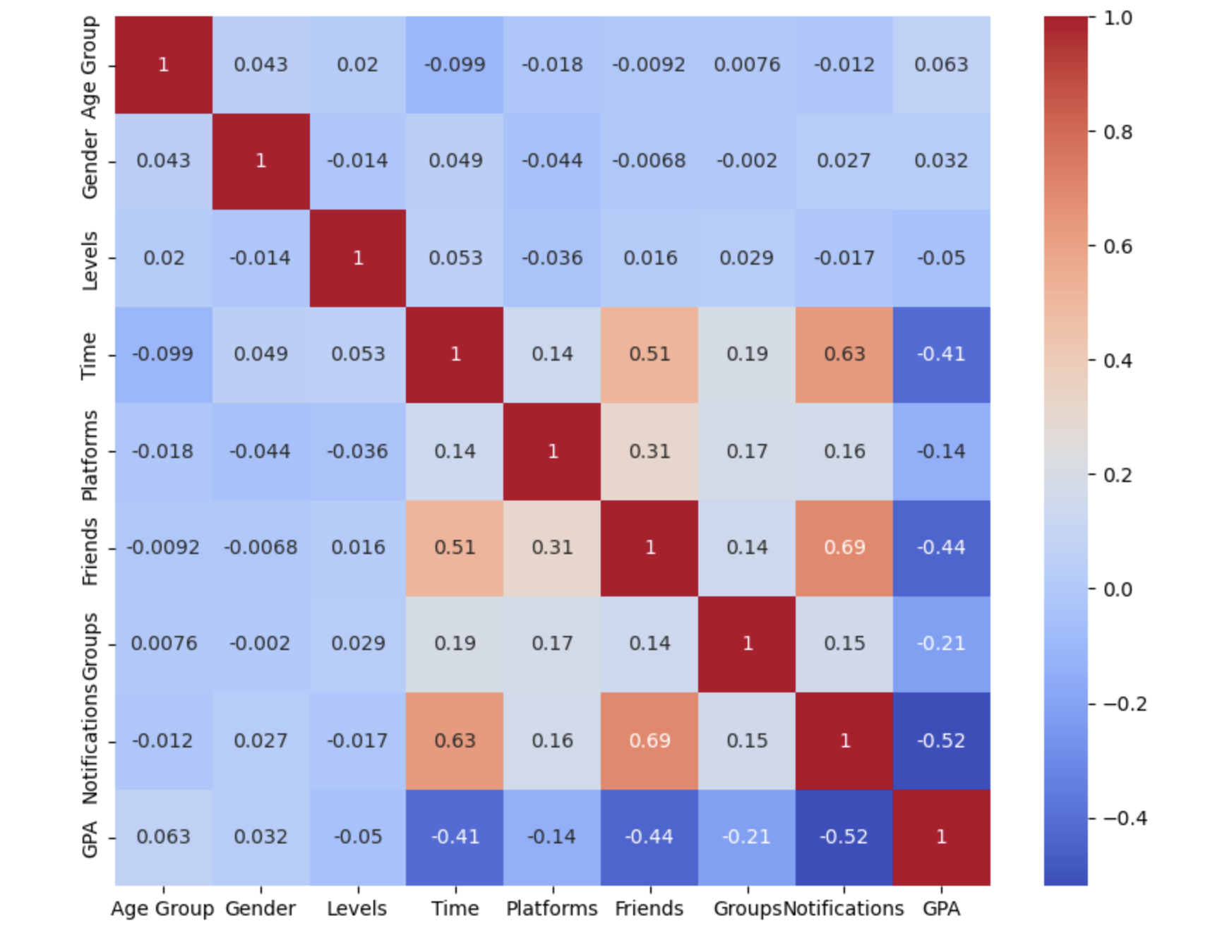
Exploratory Data Analysis (EDA) and Feature Engineering
Frontier Tech Leaders Programme Global Cohort 1

Slide 19
Exploratory Data Analysis (EDA) and Feature Engineering
Frontier Tech Leaders Programme Global Cohort 1
Based on the proposed SMIF model, the following null hypotheses were set up:
Null hypothesis (Ho) | Alternative hypothesis (Ha)
Time spent on social media has no significant association with the student’s GPA. | Time spent on social media has significant association with the student’s GPA.
Number of friends on social media has no significant association with the student’s GPA. | Number of friends on social media has significant association with the student’s GPA.
Belonging to several social media groups has no significant association with the student’s GPA. | Belonging to several social media groups has significant association with the student’s GPA.
Number of notifications checked has no significant association with the student’s GPA. | Number of notifications checked has significant association with the student’s GPA.
Using multiple social media platforms has no signifcant association with student’s GPA. | Using multiple social media platforms has significant association with student’s GPA

Slide 20
Exploratory Data Analysis (EDA) and Feature Engineering
Frontier Tech Leaders Programme Global Cohort 1
Based on the proposed SMIF model, the following null hypotheses were set up:
Null hypothesis (Ho) | Alternative hypothesis (Ha)
Age group has no significant association with the student’s GPA. | Age group has significant association with the student’s GPA.
Level of student has no significant association with the student’s GPA. | Level of student has significant association with the student’s GPA.
Student’s sex to several social media groups has no significant association with the student’s GPA. | Student’s sex to several social media groups has association with the student’s GPA.

Slide 21
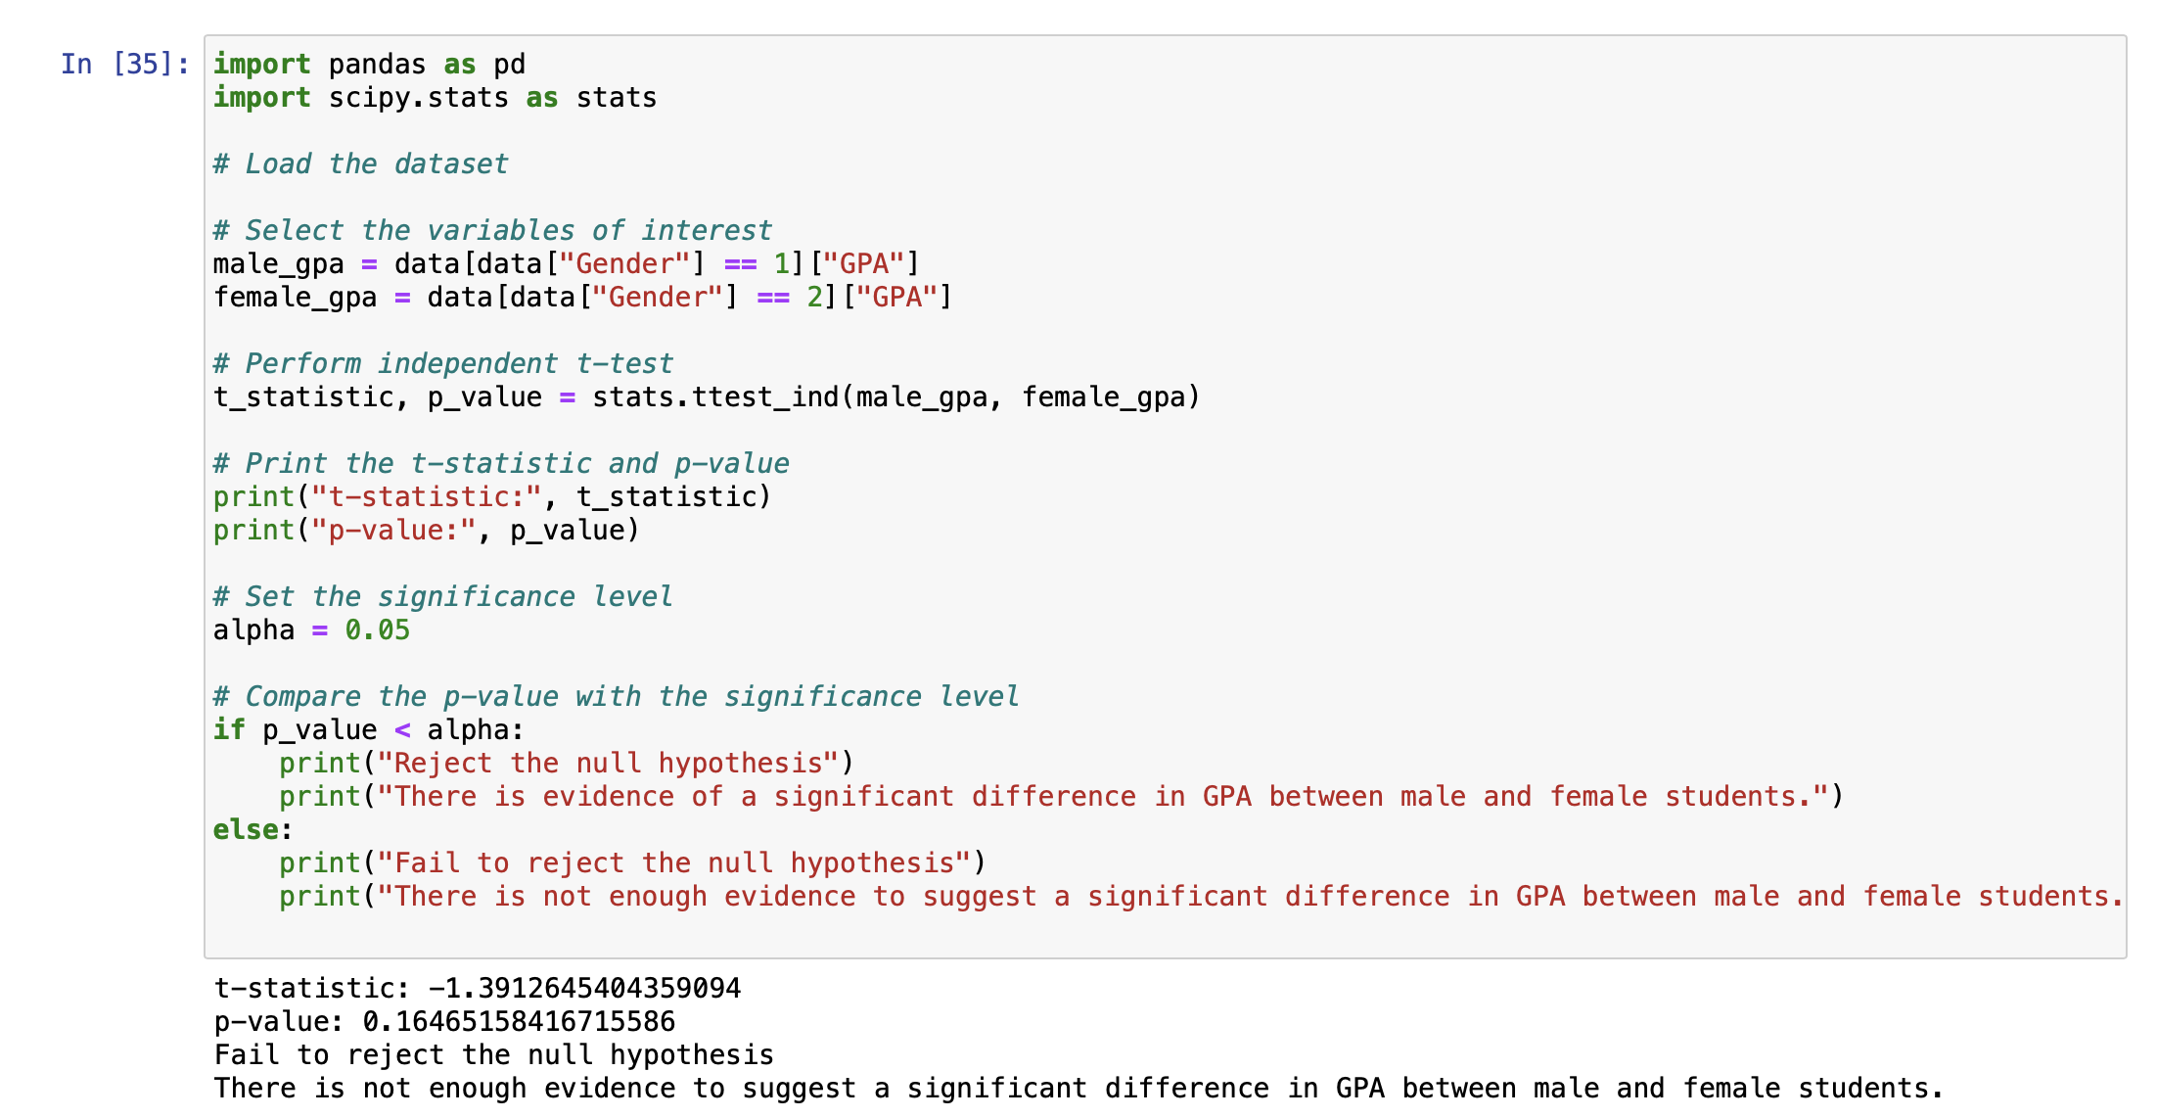
Exploratory Data Analysis (EDA) and Feature Engineering
Frontier Tech Leaders Programme Global Cohort 1

Slide 22
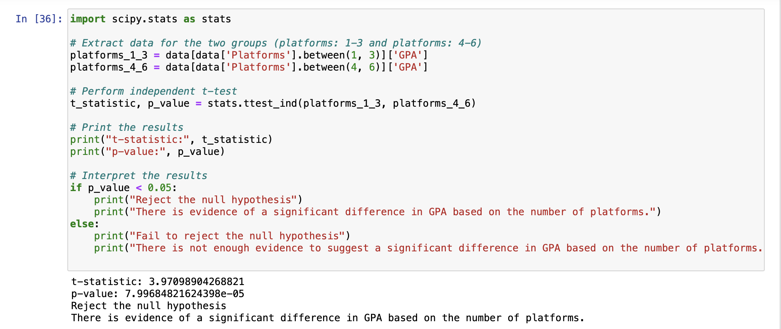
Exploratory Data Analysis (EDA) and Feature Engineering
Frontier Tech Leaders Programme Global Cohort 1

Slide 23
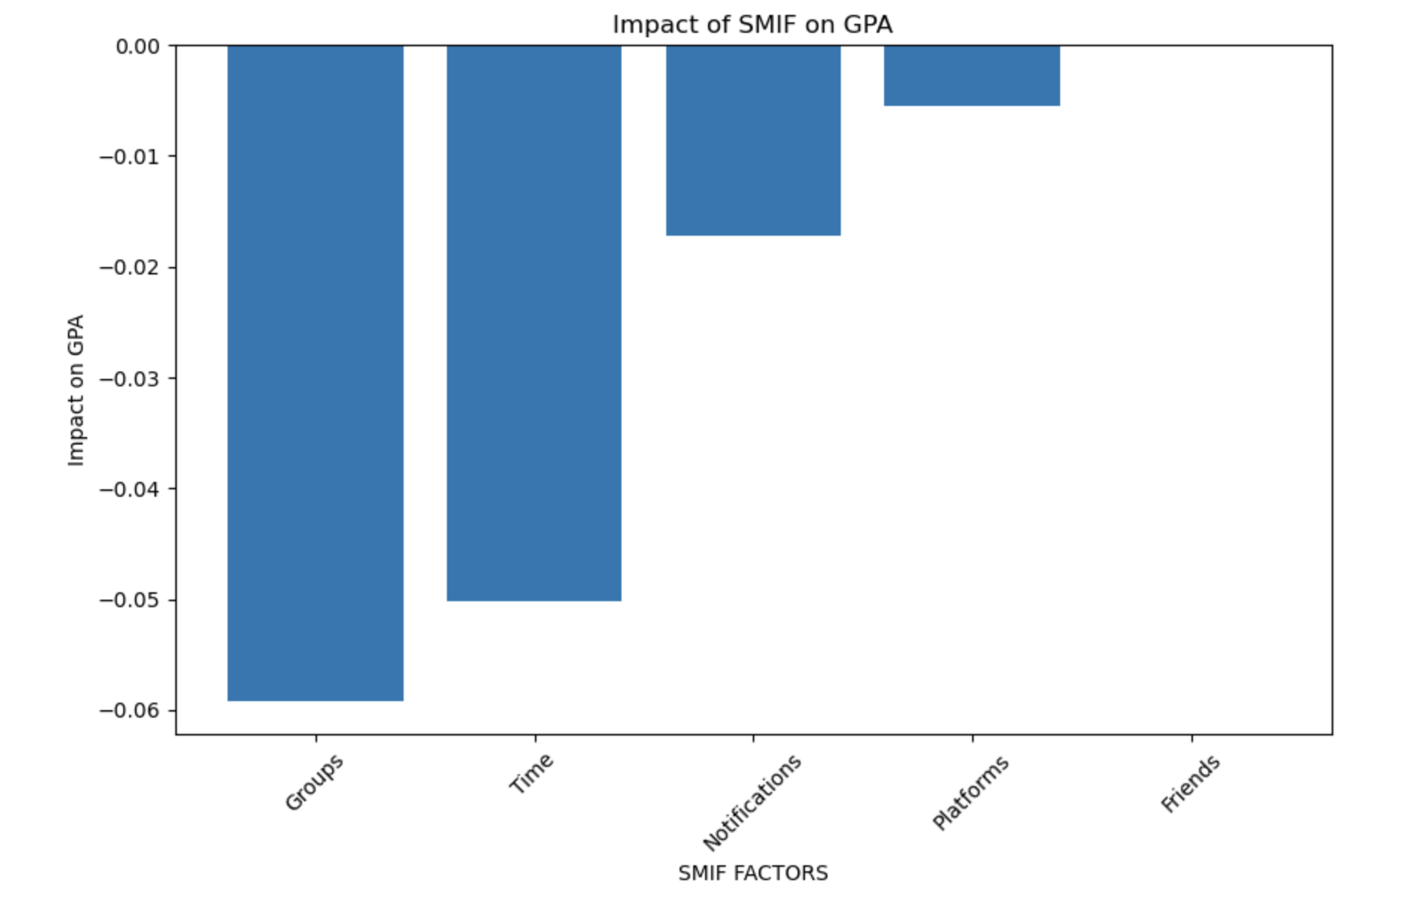
Exploratory Data Analysis (EDA) and Feature Engineering
Frontier Tech Leaders Programme Global Cohort 1

Slide 24
Model
Frontier Tech Leaders Programme Global Cohort 1

Slide 25
Model Selection and Training
Frontier Tech Leaders Programme Global Cohort 1
The project will follow a two-step methodology. In the first step, the focus is on predicting GPA (a continuous value). Various machine learning algorithms will be explored for regression tasks. The algorithms to be considered include, but are not limited to:
Linear Regression: Suitable for establishing a linear relationship between social media metrics and GPA.
Decision Trees: Effective in capturing non-linear relationships and feature interactions.
Random Forest: An ensemble method that excels in handling complex datasets and providing feature importance insights.
Gradient Boosting: Useful for boosting the predictive accuracy by combining weak learners.
Support Vector Machines (SVM): Beneficial for regression tasks, especially when dealing with high-dimensional data.

Slide 26
Model Selection and Training
Frontier Tech Leaders Programme Global Cohort 1
In the second step, a new feature "Performance" will be engineered based on GPA values, categorizing them into high (0), medium (1), and low (2). This transforms the problem into a classification task. For this, classification algorithms will be explored, including:
Logistic Regression: Applicable for binary or multiclass classification tasks.
K-Nearest Neighbors (KNN): Effective in capturing local patterns in the data.
Random Forest Classifier: Extending its application from regression to classification tasks.
Support Vector Machines (SVM): Well-suited for classification tasks, especially when there's a need to handle non-linear decision boundaries.
This two-step approach allows for a comprehensive analysis of social media influence metrics on academic outcomes, exploring both regression and classification perspectives. The selected algorithms provide a diverse set of tools to address the complexity of the relationship between social media engagement and academic performance.

Slide 27
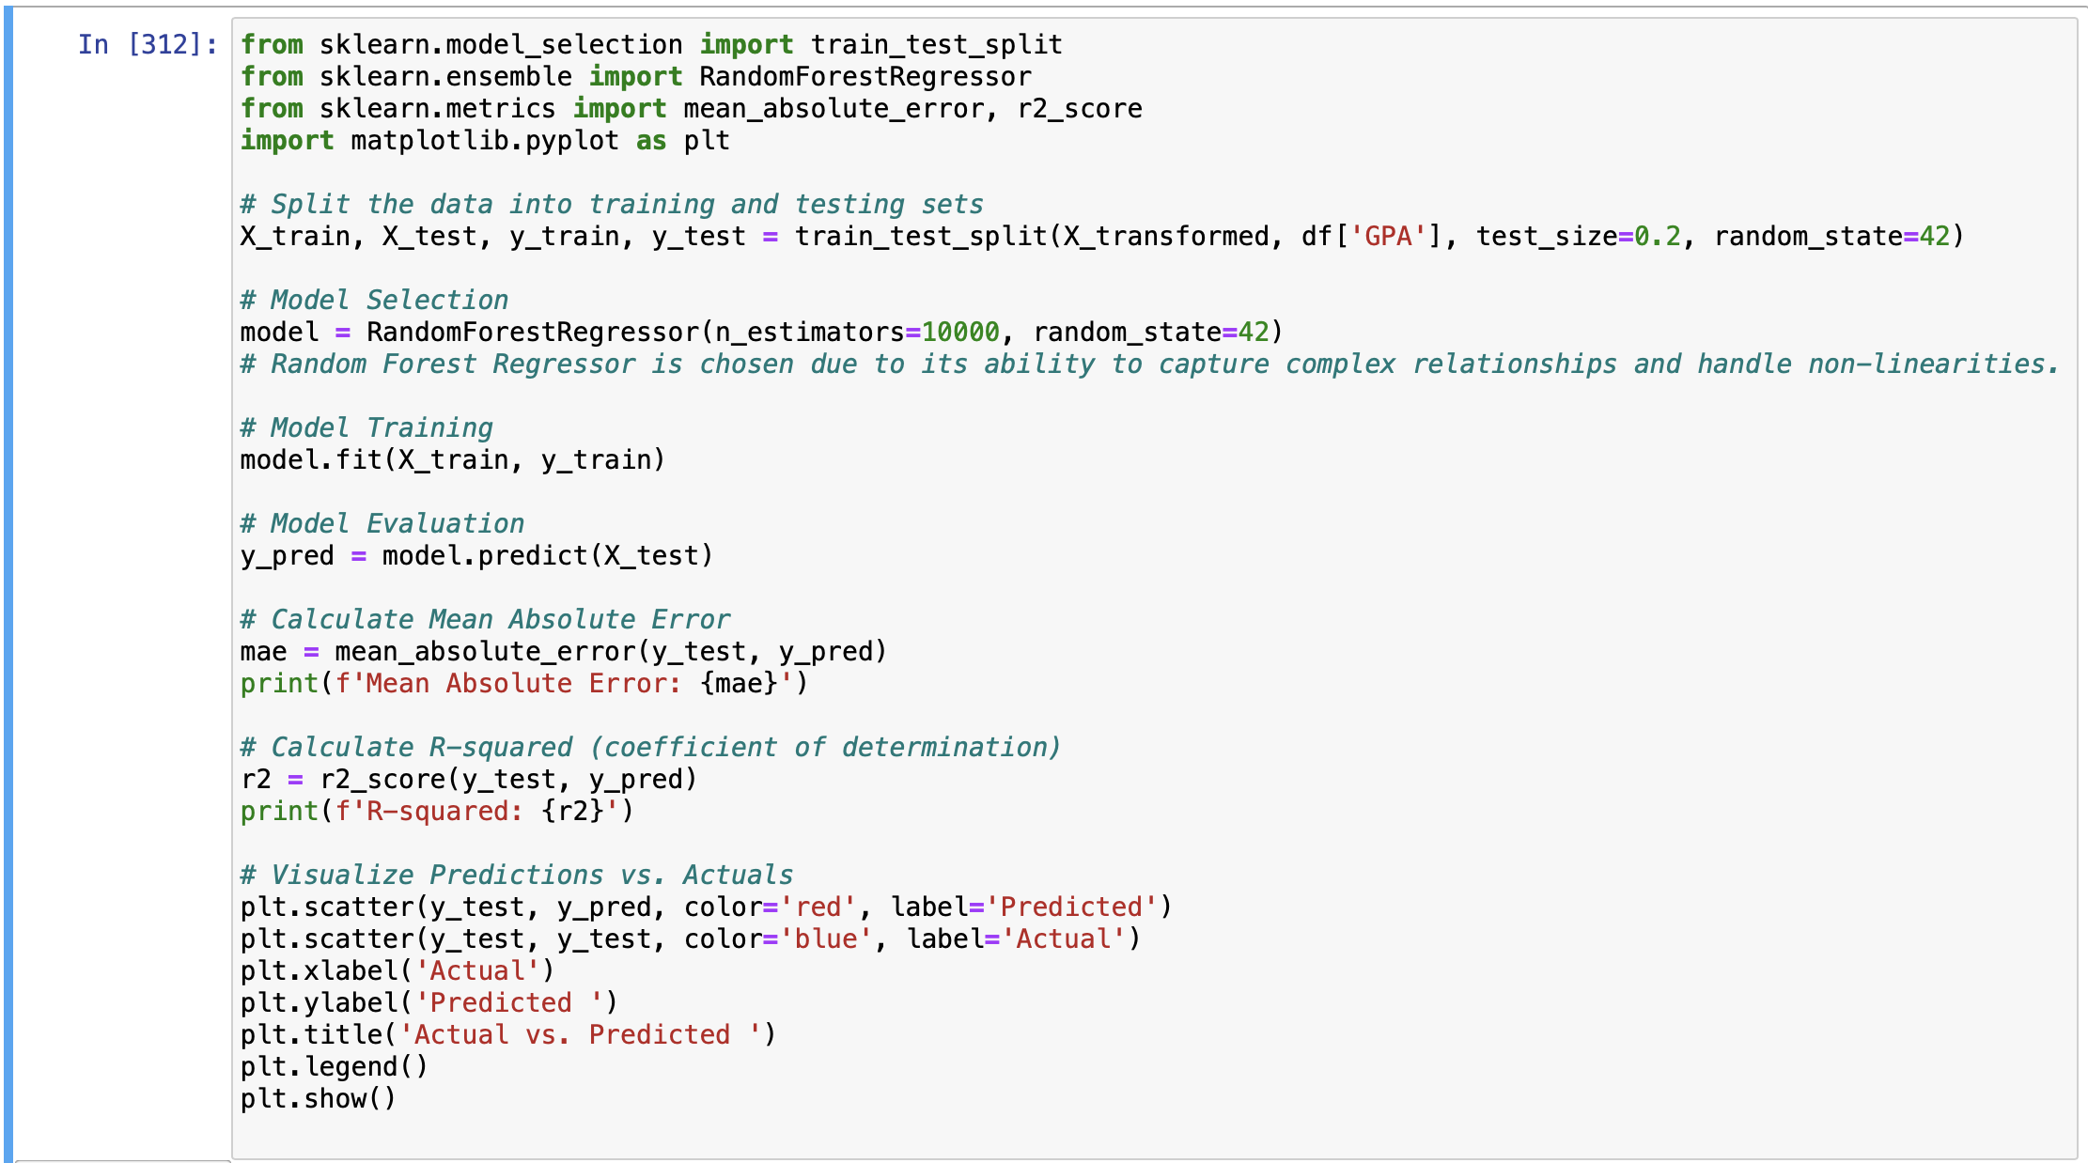
Model Evaluation and Hyperparameter Tuning
Frontier Tech Leaders Programme Global Cohort 1

Slide 28
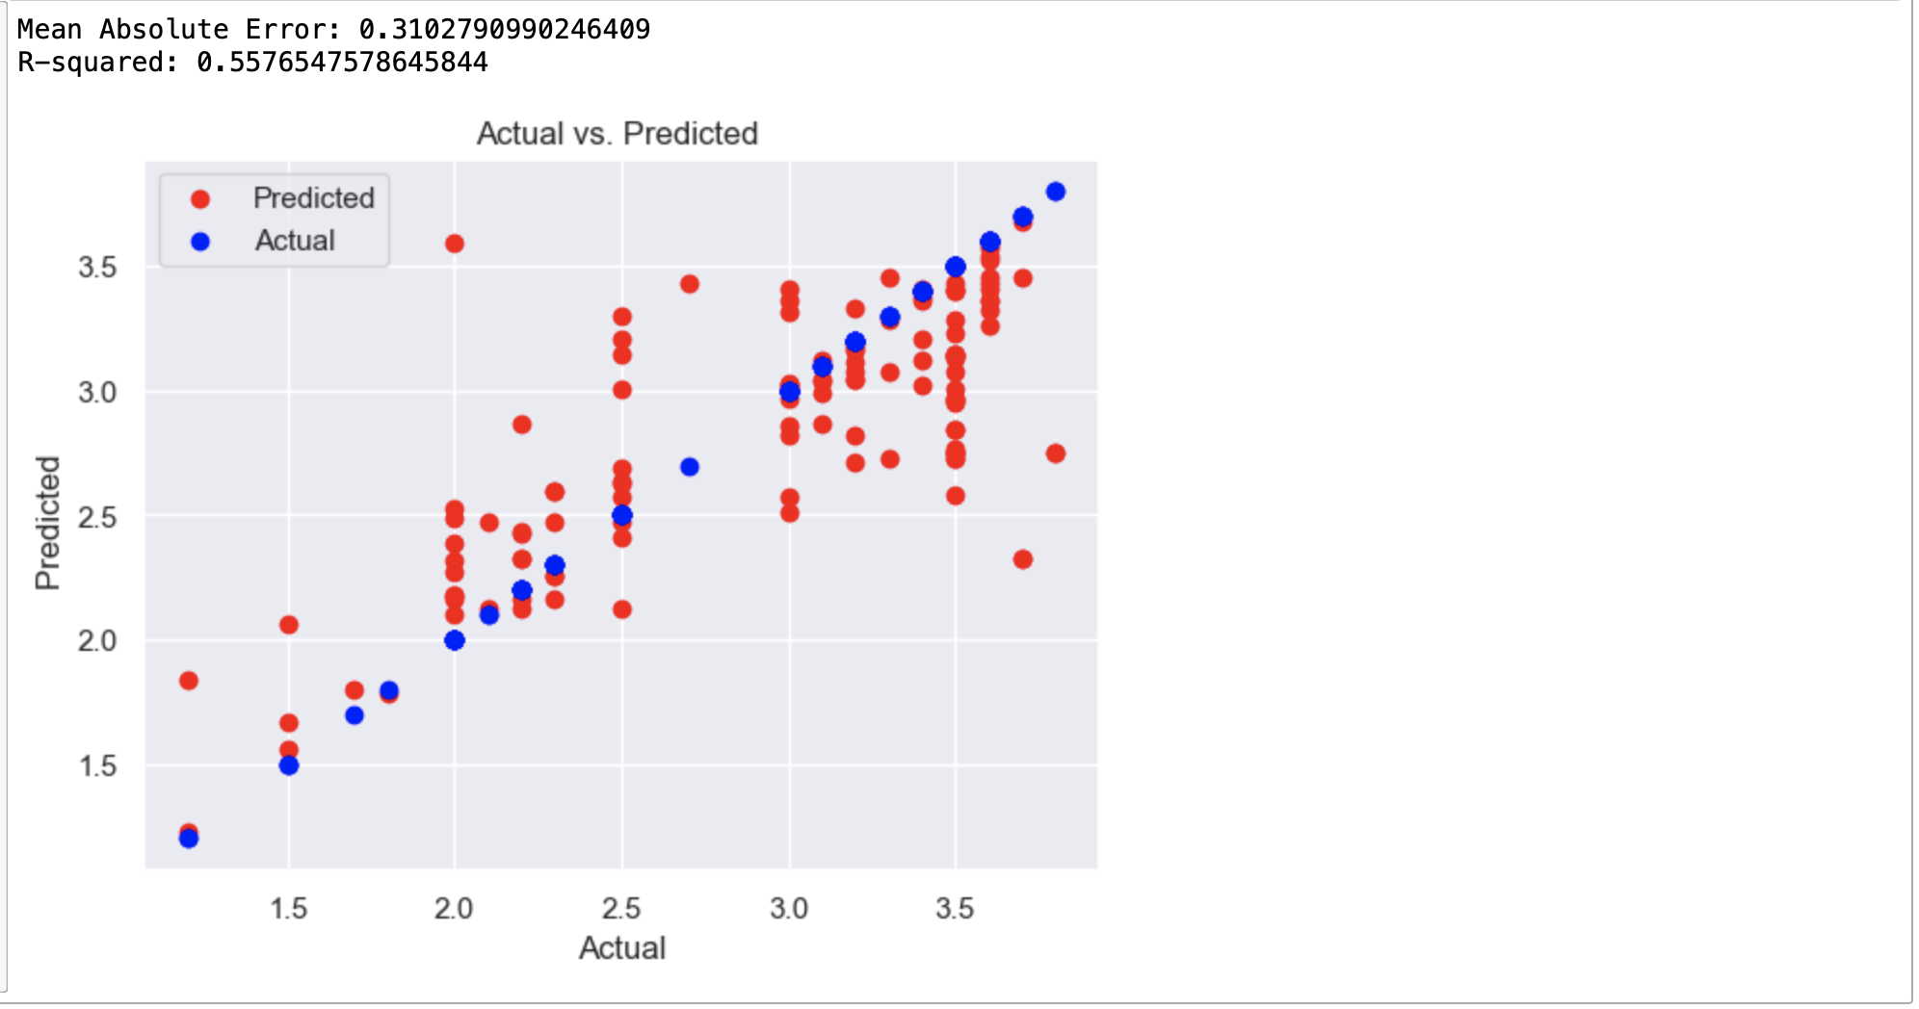
Model Evaluation and Hyperparameter Tuning
Frontier Tech Leaders Programme Global Cohort 1

Slide 29
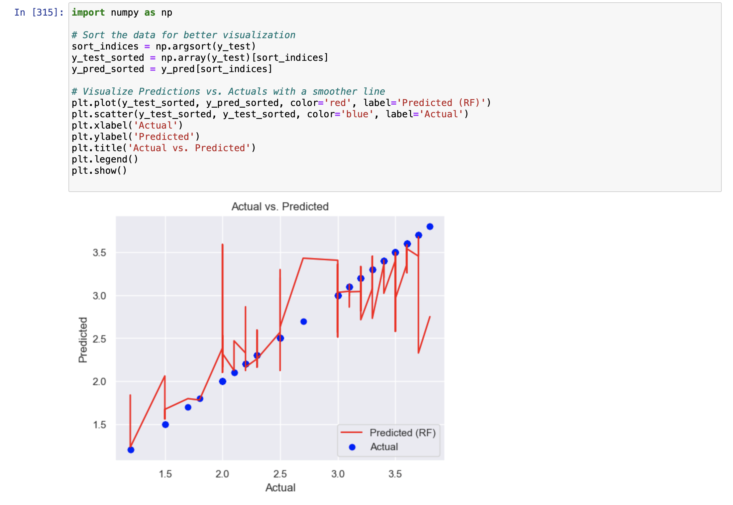
Model Evaluation and Hyperparameter Tuning
Frontier Tech Leaders Programme Global Cohort 1

Slide 30
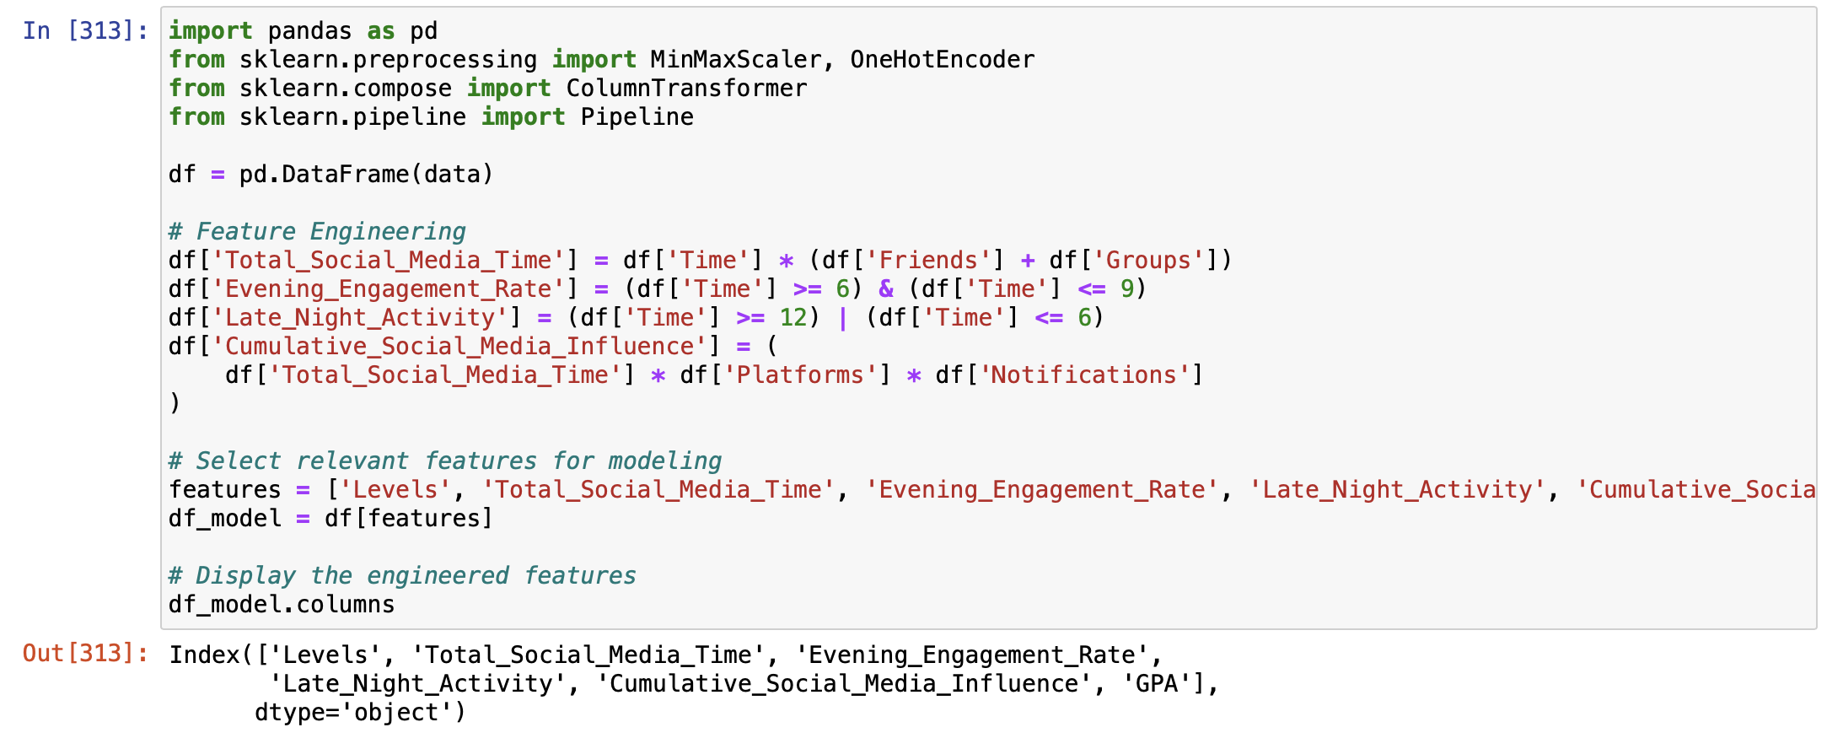
Model Refinement and Testing
Frontier Tech Leaders Programme Global Cohort 1
In our dataset focused on social media influence metrics, we conducted feature engineering to enhance the dataset's richness and gain deeper insights into the connection between social media behavior and academic performance. The new features include 'Total_Social_Media_Time,' a composite metric calculated as the product of time spent and the sum of friends and groups. Additionally, 'Evening_Engagement_Rate' captures engagement during evening hours, 'Late_Night_Activity' identifies engagement during late hours, and 'Cumulative_Social_Media_Influence' represents an aggregated influence metric. These engineered features, combined with the original 'GPA,' are organized into the 'df_model' DataFrame, laying the foundation for further analysis and exploration of the intricate dynamics between social media interactions and students' academic achievements.

Slide 31
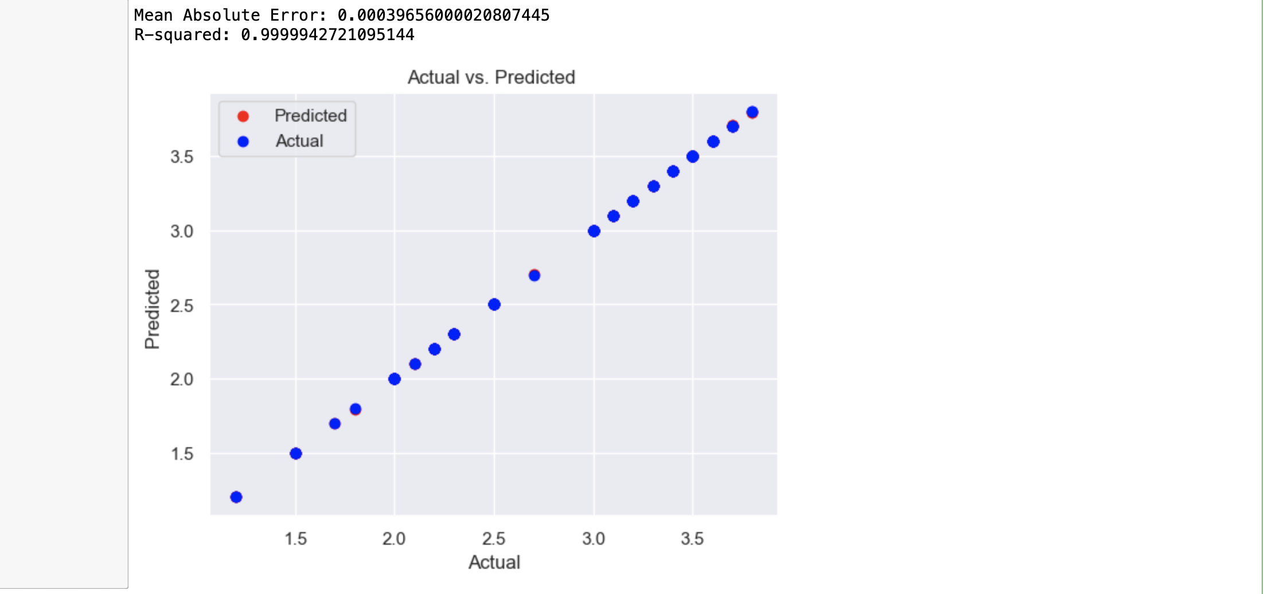
Model Refinement and Testing
Frontier Tech Leaders Programme Global Cohort 1

Slide 32
Results
Frontier Tech Leaders Programme Global Cohort 1

Slide 33
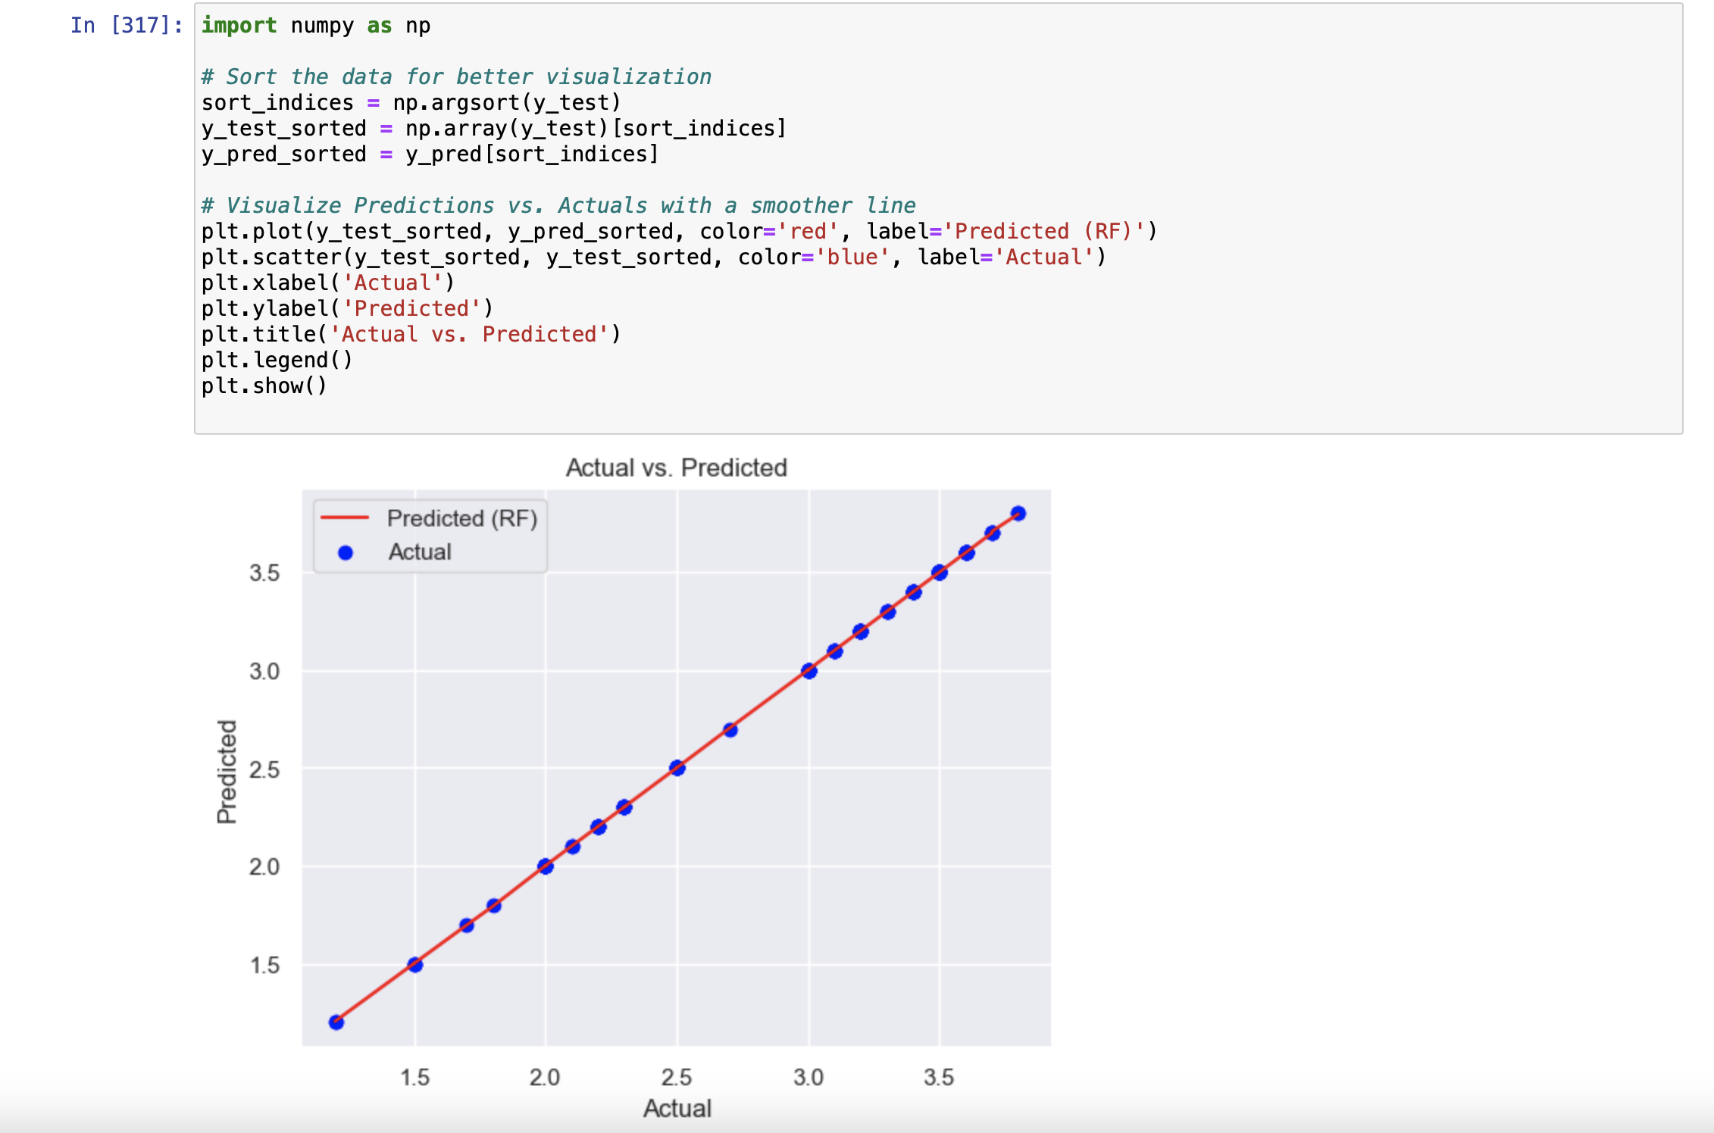
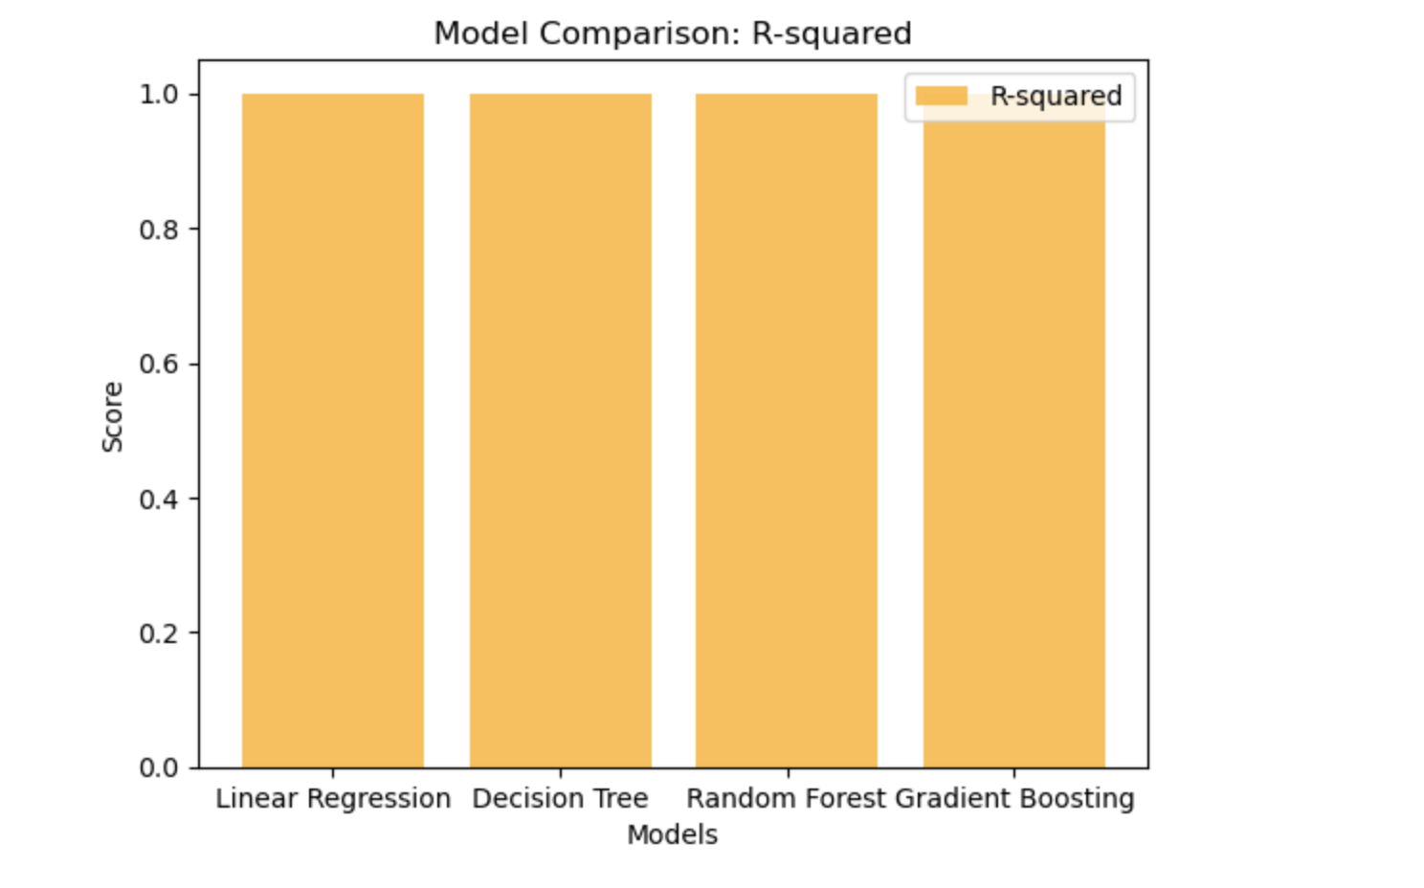
Evaluation Results
Frontier Tech Leaders Programme Global Cohort 1

Slide 34
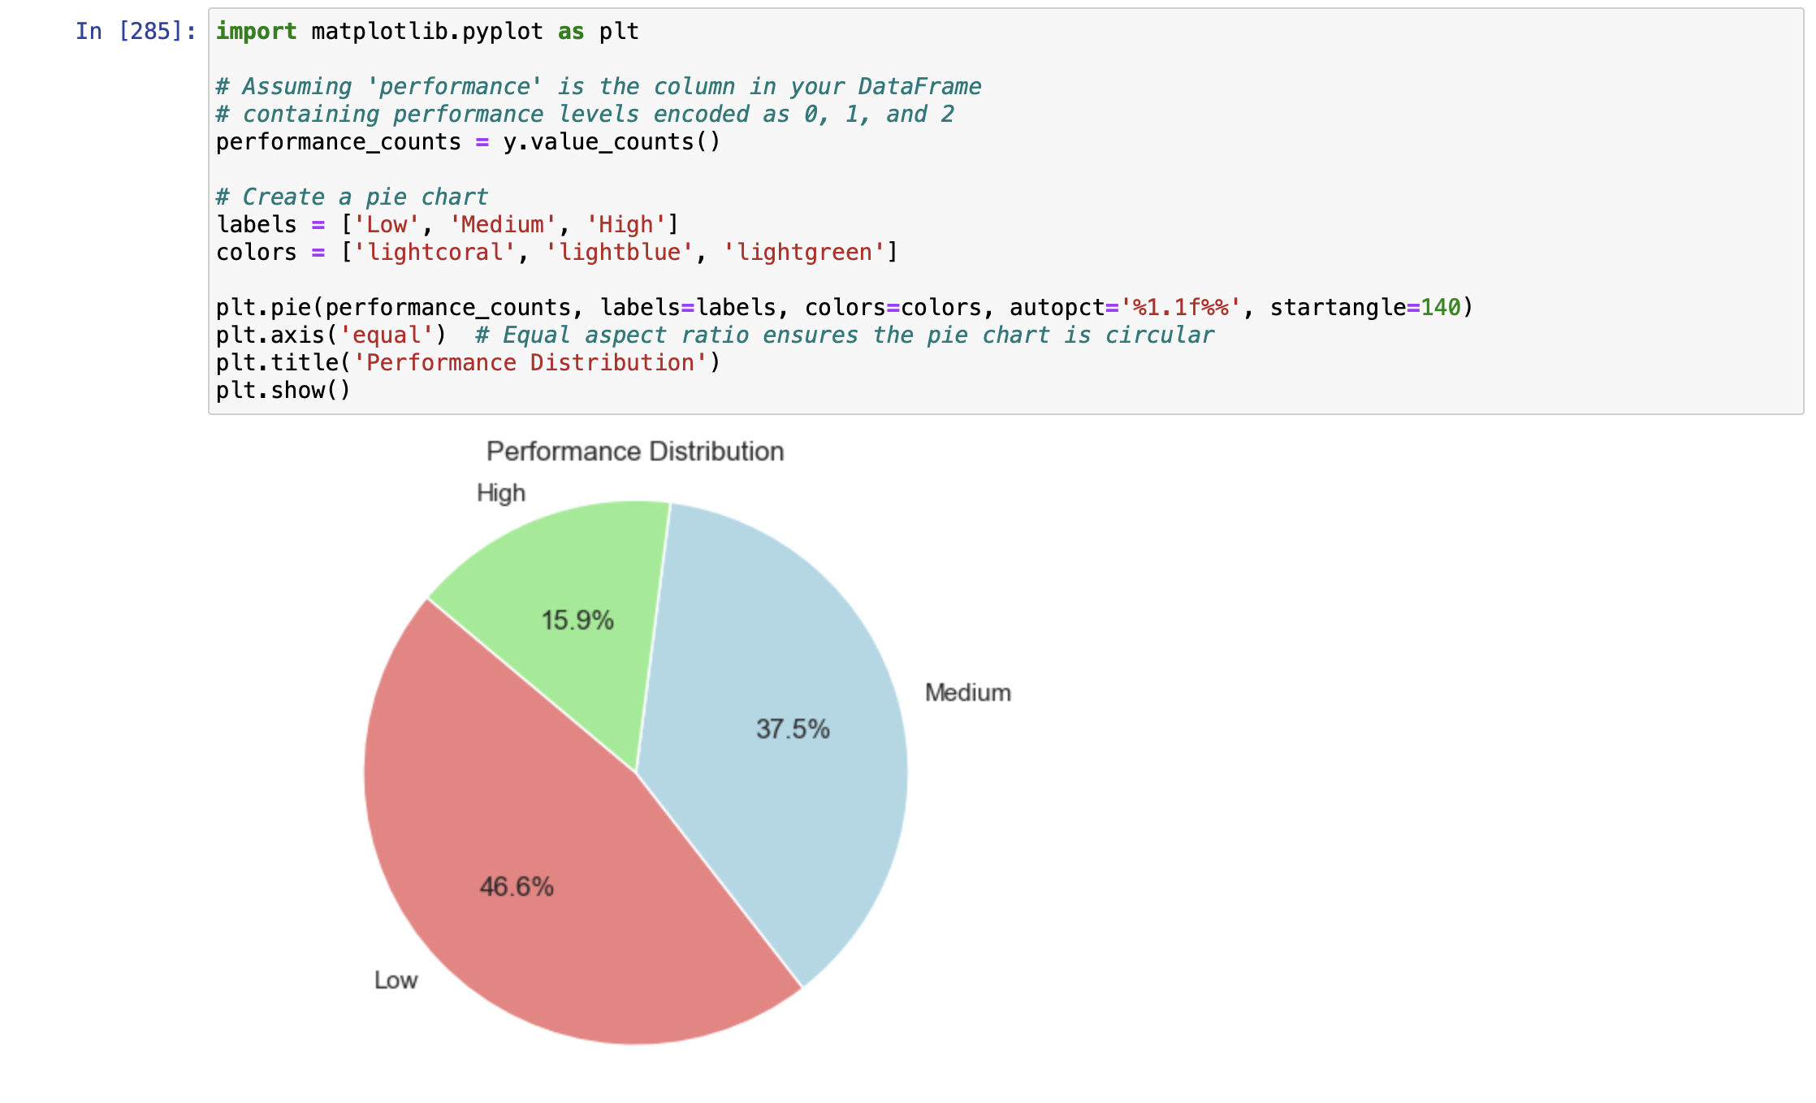
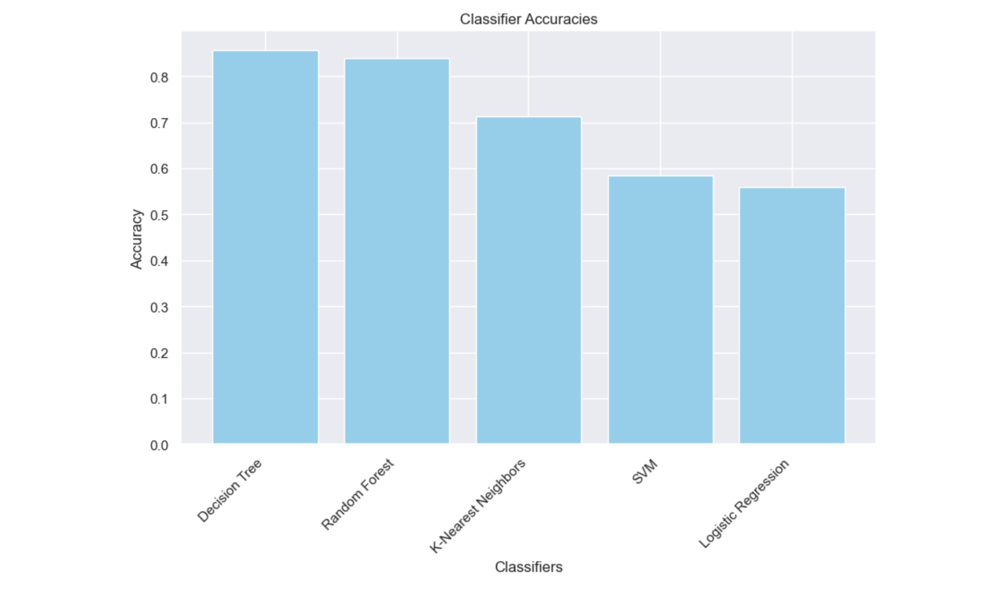
Evaluation Results
Frontier Tech Leaders Programme Global Cohort 1

Slide 35
Future Work
Frontier Tech Leaders Programme Global Cohort 1
Sentiment Analysis
Interaction Patterns
External Factors

Slide 36
References
Frontier Tech Leaders Programme Global Cohort 1
"Measuring the effect of social media on student academic performance using a social media influence factor model" - The paper aims to evaluate the influence of social media on student academic performance by introducing a Social Media Influence Factor (SMIF) model and revealing a statistically significant negative relationship between SMIF variables and student grade point average (GPA).
"Social Media Influence on Student Success: A Comprehensive Analysis" - This literature review provides insights into various social media influence factors and their potential effects on academic success, serving as a reference for our project.

Slide 37


Thank you!
Frontier Tech Leaders Programme Global Cohort 1

